Slide 1
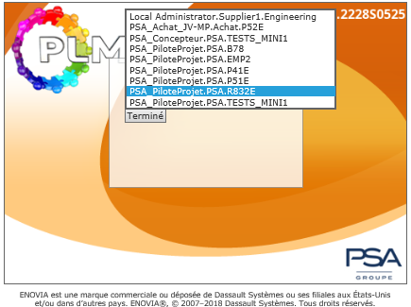
Stellantis · PLM onboarding · Module 01
ENOVIA V6R2013x · PLM platform V3.1.11
Log in to PLM
01
Everything you need for your first connection: access rights, Security Context, and a guided tour of the ENOVIA interface.
1 · Security Context
2 · Two ways to connect
3 · Interface tour
Redesigned edition · content sourced from "1 PLM INTERFACE.pptx"
13 slides · about 10 minutes

Slide 2
Agenda
What this module covers
Four steps, from access rights to your first click.
01
02
03
04
Before you log in
The Security Context
Two ways to connect
Reading the interface
PLM access and a Security Context. Both are requested in PLMPassport.
Role + Organization + Project — the key that grants your creation rights.
The PLM icon in the CFAO palette, or the direct intranet address.
Toolbar zones A, B and C — plus the one habit to unlearn.
Prerequisites
Core concept
Access
Navigation
Each step builds on the previous one.
PLM · ENOVIA V6 · Log in to PLM
02 / 13

Slide 3
Step 01 · Before you start
Two things must be true before your first login
Without both, PLM opens — but you cannot create anything.
The chain
1
PLM access
Access granted
Your account must be granted access to the PLM platform. Access requests are raised in PLMPassport.
Your PLM account is active.
Context assigned
Role · Organization · Project.
2
Security Context
A Security Context grants you creation rights in PLM, based on your role and the project you are working on.
You can create
Prototypes, documents, changes.
Missing one of them? Raise the request in PLMPassport before your first login.
PLM · ENOVIA V6 · Log in to PLM
03 / 13

Slide 4
Step 02 · Core concept
A Security Context = Role + Organization + Project
It tells PLM what you may create, and on which project.
R
O
P
Role
Organization
Project
PiloteProjet
PSA
e.g. R832E
Defines what you may do. Creating the expected prototypes requires the PiloteProjet role.
The organization you act for. For these prototypes, the organization is PSA.
The project you are required to work on — one context covers one project.
Required for prototype creation: PSA_PiloteProjet . PSA . your project
PLM · ENOVIA V6 · Log in to PLM
04 / 13

Slide 5
Step 02 · How to read it
Anatomy of a context string
Every Security Context is written as three parts, separated by dots.
PSA_PiloteProjet
.
PSA
.
R832E
Role
Organization
Project
what you may do
who you act for
where you work
As displayed in PLM
One context at a time
You can only use one Security Context per project. If you change project, you change Security Context.
The project code is the part that changes when you switch project: R832E, EMP2, P41E, B78 …
PLM · ENOVIA V6 · Log in to PLM
05 / 13

Slide 6

Step 02 · Rules
Three rules to remember
Short list. No exceptions.
01
02
03
One context per project
Contractors
One door for requests
You can only use one Security Context per project. If you change project, you change Security Context.
If you are a contractor, the request is made by your STELLANTIS client — not by you.
All PLM access requests go through PLMPassport — for yourself or for a colleague.
Rule of thumb — your Security Context always matches the project you are working on right now.
PLM · ENOVIA V6 · Log in to PLM
06 / 13

Slide 7
Step 02 · Request access
Request your access in PLMPassport
One portal for every PLM access request.
1
Open PLMPassport
plmpassport.inetpsa.com — the entry point for PLM rights.
Request portal
plmpassport.inetpsa.com
/index.php/home
2
Raise the request
For yourself, or on behalf of a colleague who needs access.
PLM access requests must be made in PLMPassport.
Click the address to open the portal.
3
Receive your context
Role · Organization · Project, ready to use at your next login.
Contractors
Your STELLANTIS client is the one who makes the request on your behalf.
PLM · ENOVIA V6 · Log in to PLM
07 / 13

Slide 8
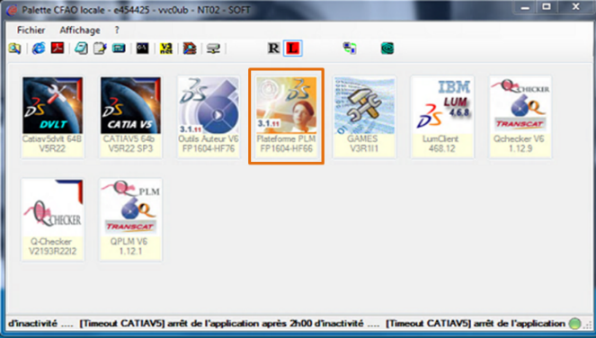
Step 03 · Connect
Two ways in
Both routes open the same PLM platform.
Route A
Route B
From the CFAO palette
Direct intranet address
On psa.com, open the CFAO palette and click the PLM Platform icon.
Paste the address into your browser on the Stellantis intranet.
http://plm.inetpsa.com/enovia/common/emxNavigator.jsp
Click to open · intranet only
Same platform, same login, same context.
Bookmark the address for daily use.
PLM · ENOVIA V6 · Log in to PLM
08 / 13

Slide 9
Step 03 · First screen
Pick your Security Context at launch
PLM opens on the splash screen and asks which context to use.
1
Every context you own is listed
The list shows all Security Contexts assigned to you.
2
Select the one for your project
Match the last part of the string to the project you are working on.
3
Confirm with Terminé
The button closes the selection and opens the PLM home page.
The context list at launch — select one, then confirm.
PLM · ENOVIA V6 · Log in to PLM
09 / 13

Slide 10
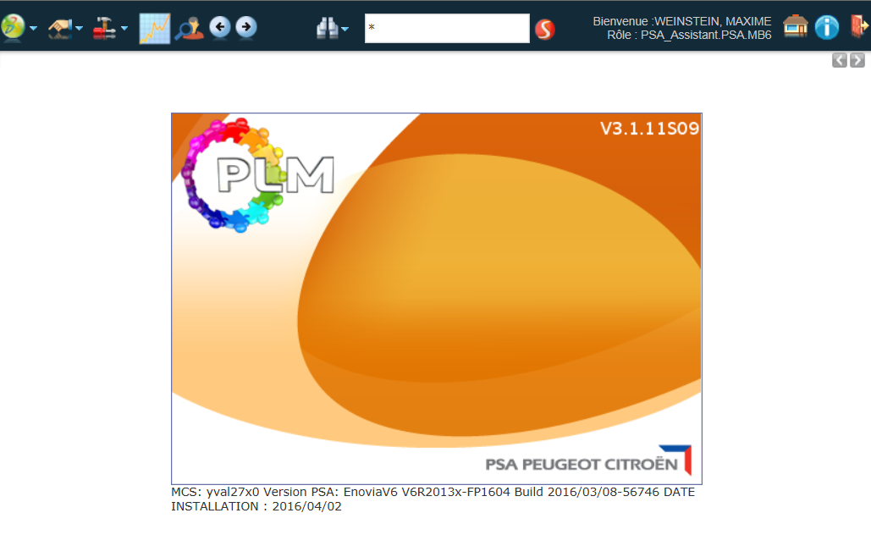
Step 04 · Interface
The home page at a glance
After login you land on the PLM home page. Everything starts from the toolbar.
your name · your role
A
B
C
A
Actions & navigation
My Enovia, Actions, Tools, PLM Indicators Portal, Previous / Next page.
B
Search tools
The quick search field and the search icons beside it.
C
Session icons
Return to the home page, platform information, and Exit PLM.
PLM home page after login — the toolbar runs across the top.
PLM · ENOVIA V6 · Log in to PLM
10 / 13

Slide 11
Step 04 · Toolbar
Zone by zone
The toolbar never changes — learn it once.
A
Zone A
B
Zone B
C
Zone C
Actions & navigation
Search tools
Session icons
My Enovia
Quick search field
Return to the home page
Actions
Search icons
Platform information
Tools
Exit PLM
PLM Indicators Portal
Previous / Next page
The two round arrows are the application’s own back and forward.
Type here to find objects without leaving the page.
Use Exit PLM to close your session properly.
A
B
C
your name · your role
The toolbar, full width — zones A, B and C.
PLM · ENOVIA V6 · Log in to PLM
11 / 13

Slide 12

Step 04 · Golden rule
Never use the browser’s back / forward buttons
PLM has its own navigation — use it.
Don’t
Do
Browser back / forward
PLM Previous / Next page
These buttons belong to the browser, not to PLM.
The two round arrows in the toolbar move you through PLM the way the application expects.
If you get lost, the home icon in zone C brings you back to the PLM home page.
PLM · ENOVIA V6 · Log in to PLM
12 / 13

Slide 13
Recap
Your first-login checklist
Five things, in order.
PLM access requested and granted in PLMPassport
Step 01
1
Security Context assigned: PiloteProjet · PSA · your project
Step 02
2
PLM launched from the CFAO palette or the intranet address
Step 03
3
Correct context selected at launch, then confirmed
Step 03
4
Navigating with the PLM toolbar — never the browser buttons
Step 04
5
Next in this series: Creating a Product ECO · PDEF / PREA lifecycle management
PLM · ENOVIA V6 · Log in to PLM
13 / 13

